Slide 1
SRS Outreach Resource Pack
Responding to a Text

Slide 2
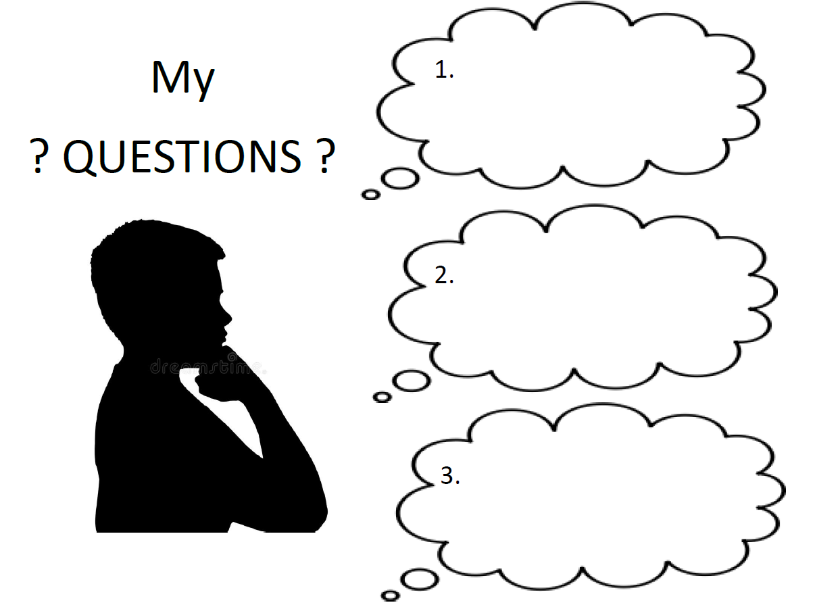


Slide 3
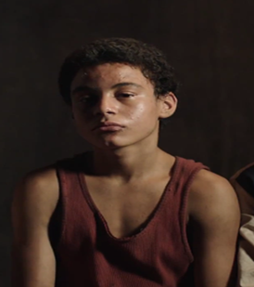
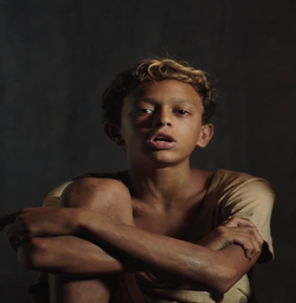

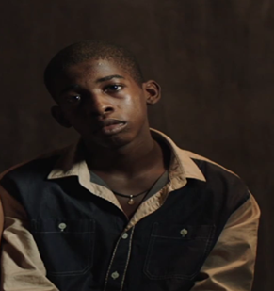
Visuals for Characters – Edit for your Text
Raphael
Rat
Gado

Slide 4
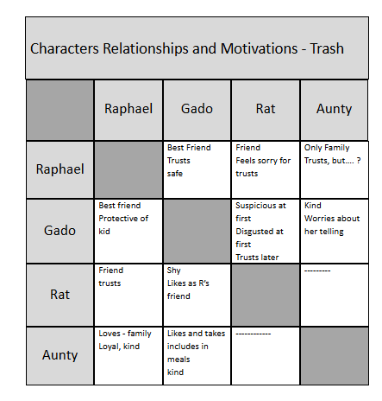
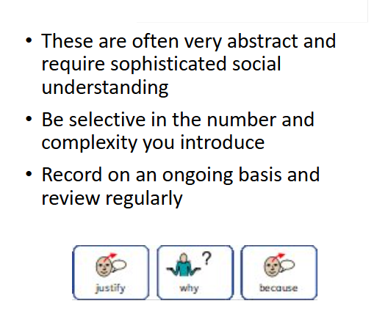
Exploring Characters’ Relationships in Depth

Slide 5
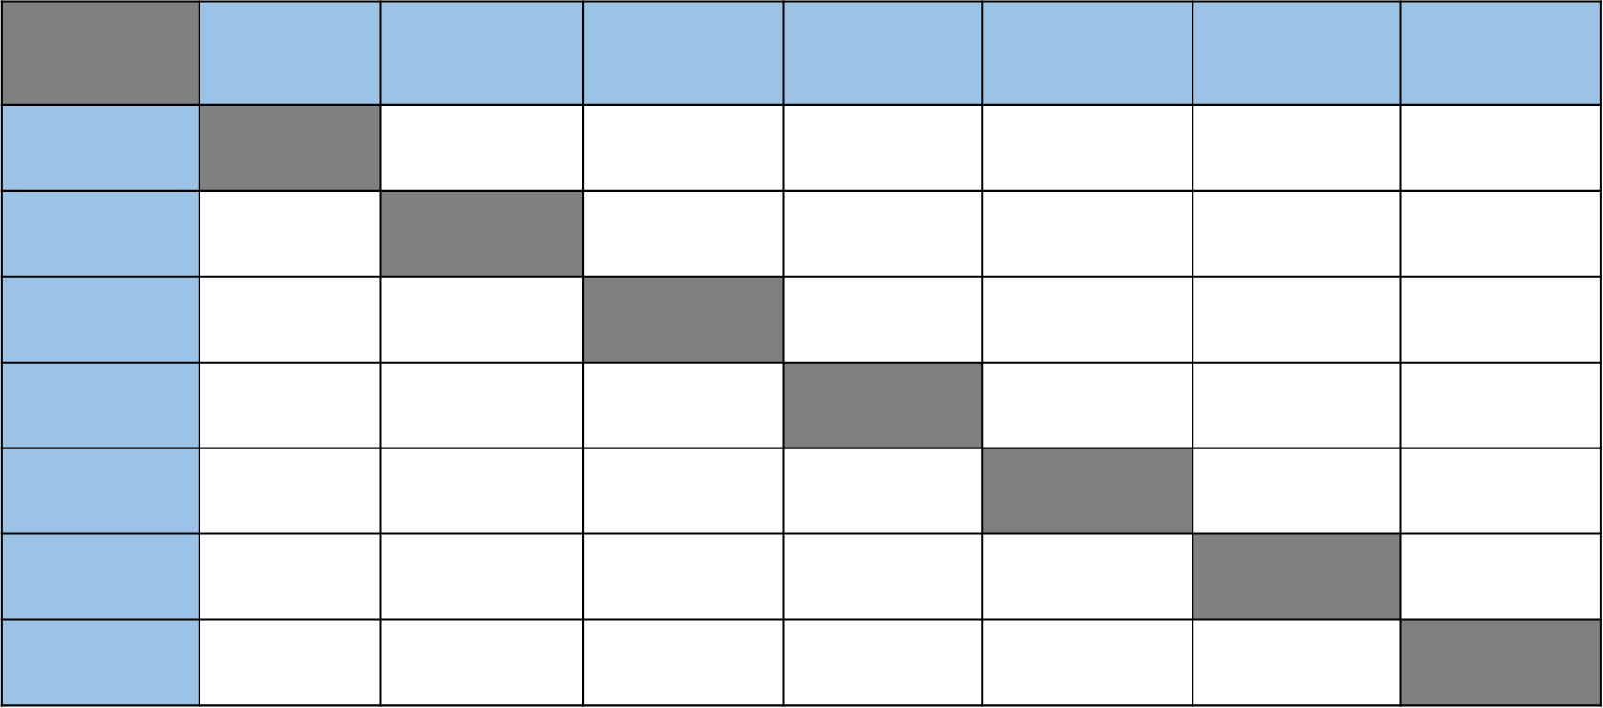

Slide 6
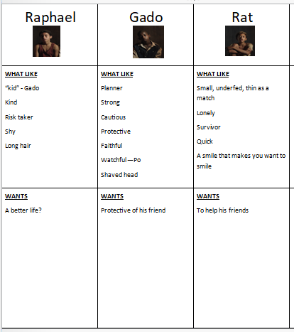
Character Analysis - Gather Evidence as you Read
LIKE | LIKE | LIKE | LIKE
WANTS | WANTS | WANTS | WANTS

Slide 7

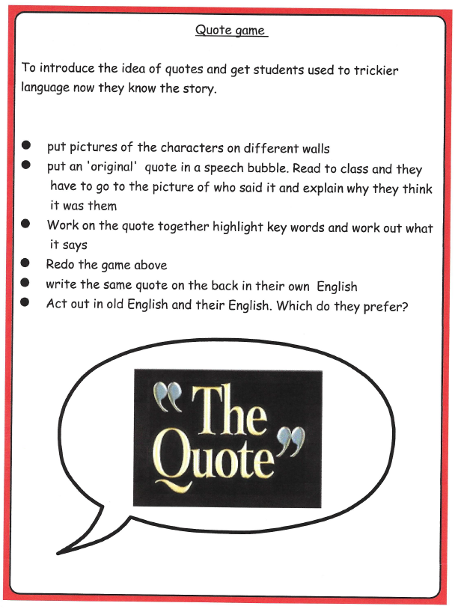
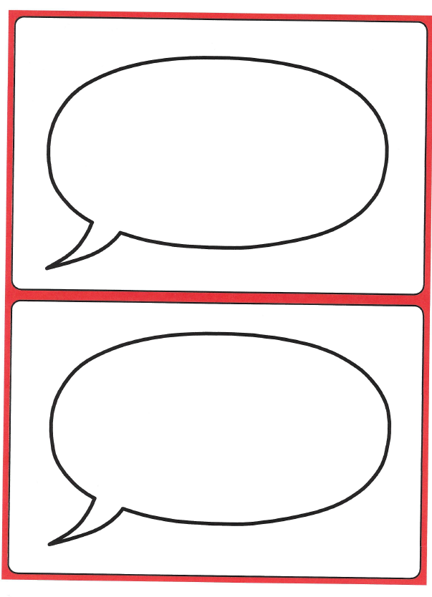

The Quote Game

Slide 8
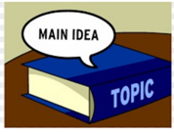

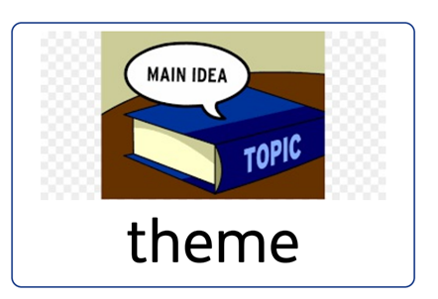
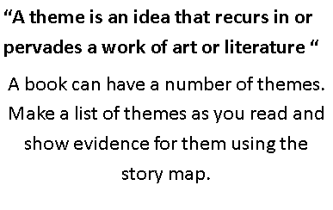
Themes | How I know

