Slide 1
SRS Outreach Resource Pack
Maths: Early Vocabulary

Slide 2
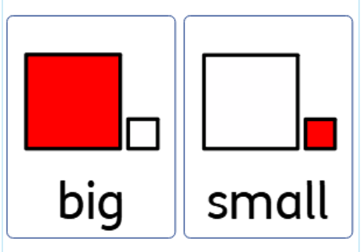
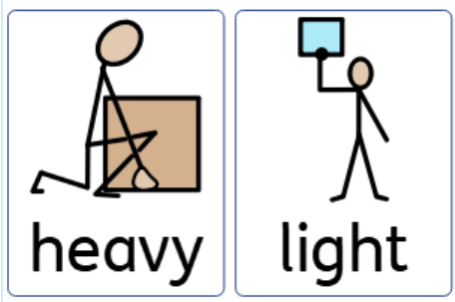
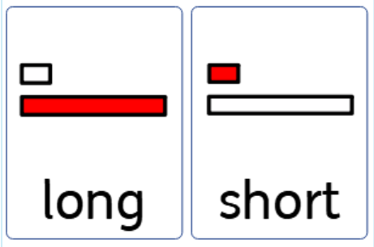
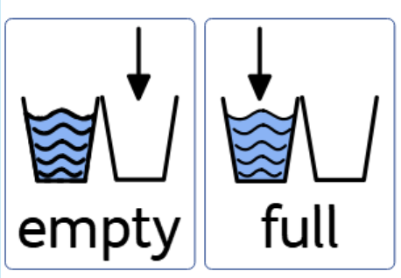

Slide 3
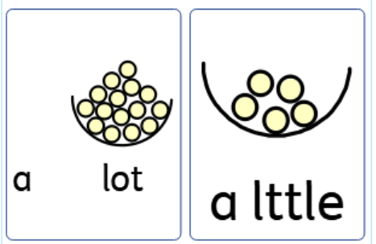
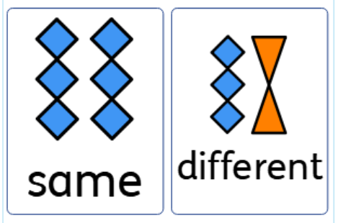
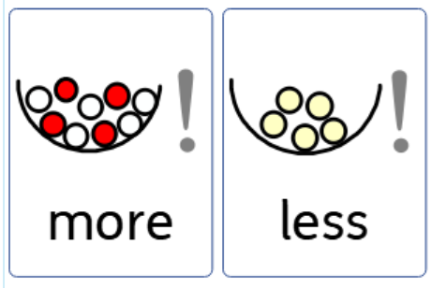
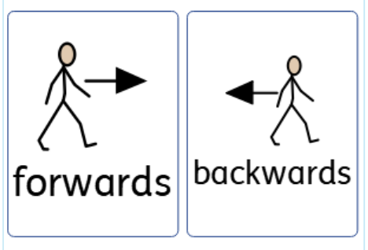

Slide 4
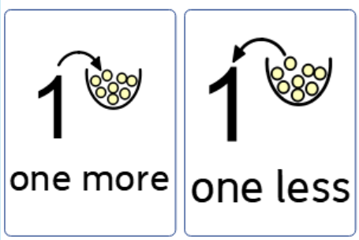
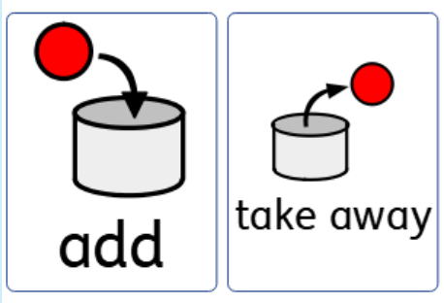
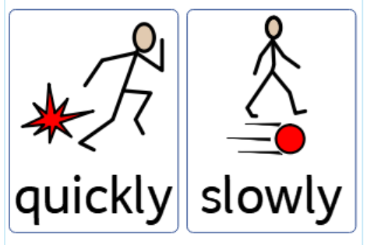
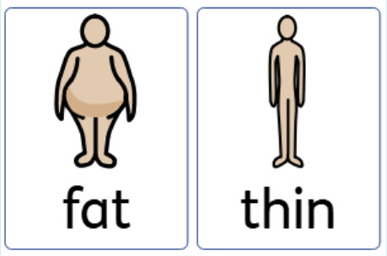

Slide 5
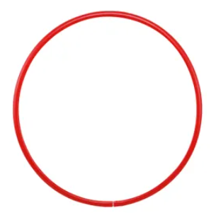






Sorting Key Concepts
Use a feely bag and PE hoops
Some students might need concrete objects to make this a concrete task
Others could use pictures

Slide 6

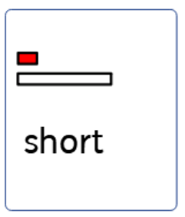
Long, Short Book
By………….

Slide 7
Brian has a long scarf.
Jenny has a short scarf.

Slide 8
Visual matching and naming - Vocabulary
When teaching core vocabulary matching is the most accessible way to begin.
Clearly name each item as it is matched.
Have written word beneath simply for exposure.
This will need frequent repetition gradually fade the amount of support a student needs.
Print and laminate 2 copies of each sheet. Cut up one copy and use to match
Hold picture card student names (or repeats)
Student places card on grid matching pictures
Retrieval – “Give me ………”

Slide 9
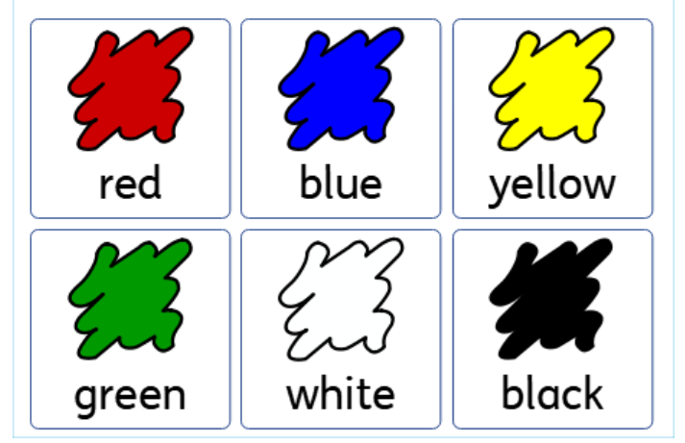

Slide 10
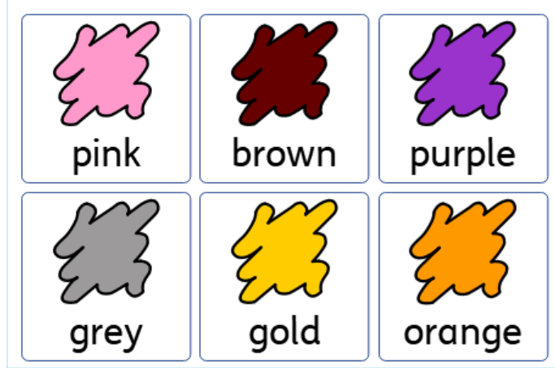

Slide 11
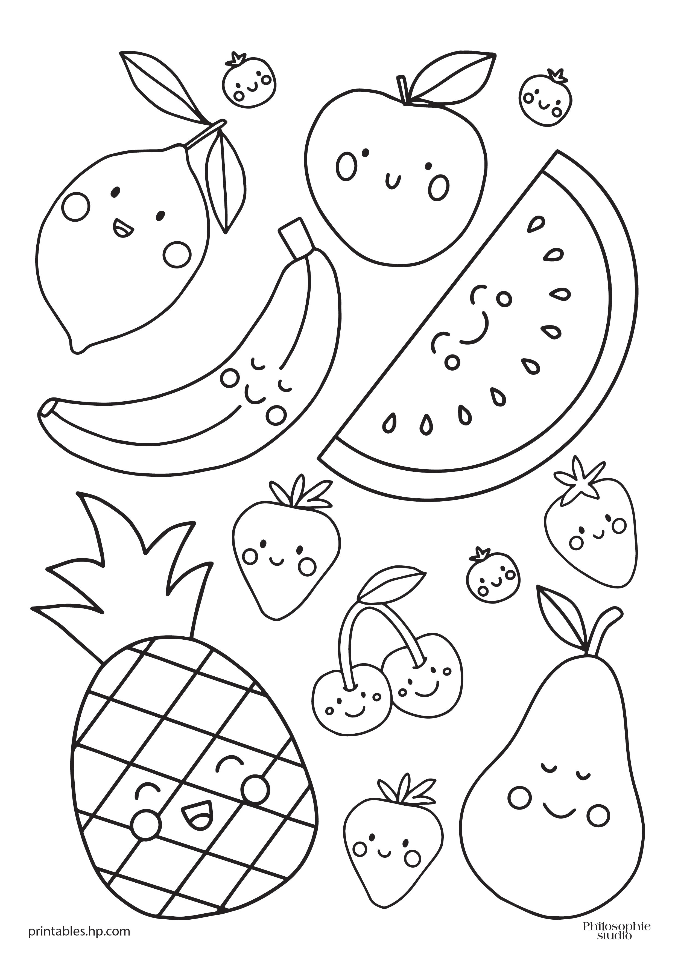
Colour the banana blue
Colour the strawberry red
Colour the pear green
Colour the pineapple yellow
Colour the cherries pink
Colour the lemon brown
Choose a colour for the watermelon

Slide 12
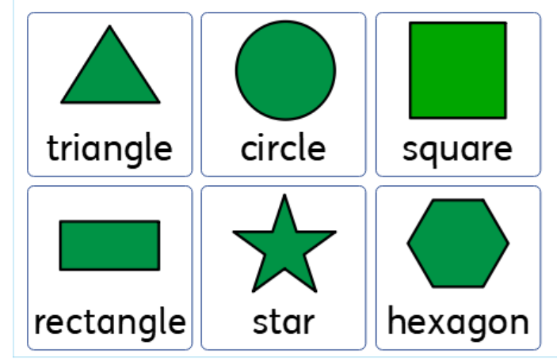

Slide 13
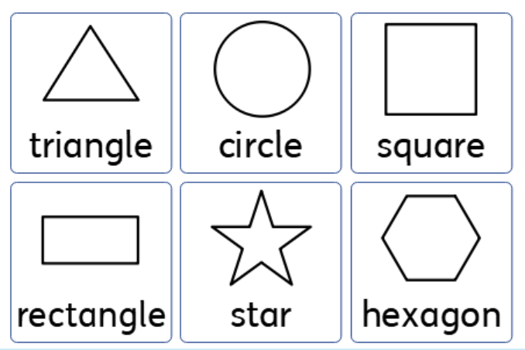
Colour the trangle blue
Colour the circle red
Colour the rectangle green
Colour the star yellow
Colour the hexagon pink
Colour the square brown

