Slide 1
SRS Outreach Resource Pack
Maths: Early Vocabulary

Slide 2
Visual matching and naming - Numbers
When teaching sequences matching is the most accessible way to begin.
Clearly name each item as it is matched.
This will need frequent repetition gradually fade the amount of support a student needs.
In sequence:
Hold number card student names (or repeats)
Student places card matching the numerals
Count from 1 in sequence
When secure try sequencing on a blank number line

Slide 3
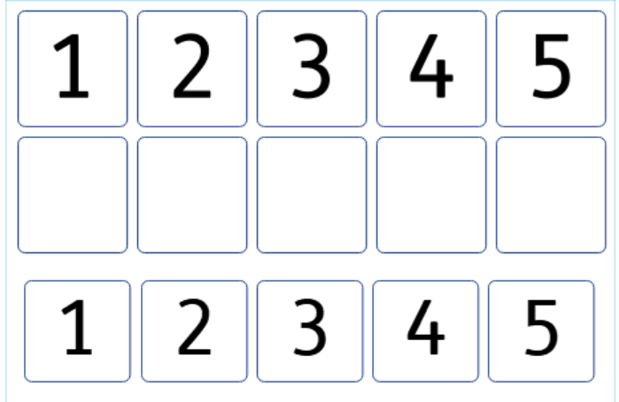

Slide 4
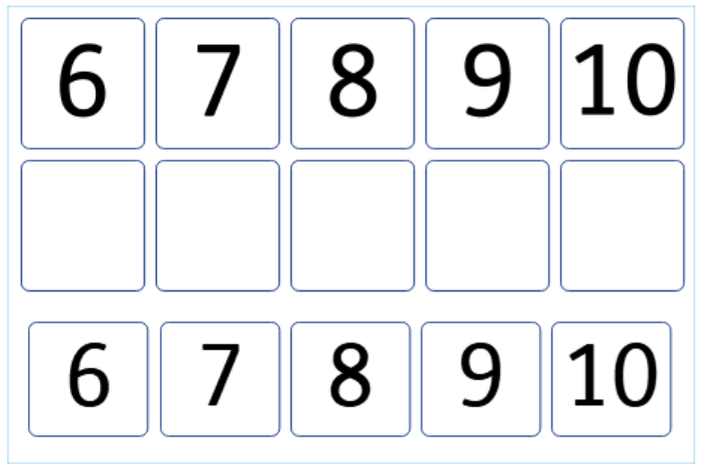

Slide 5
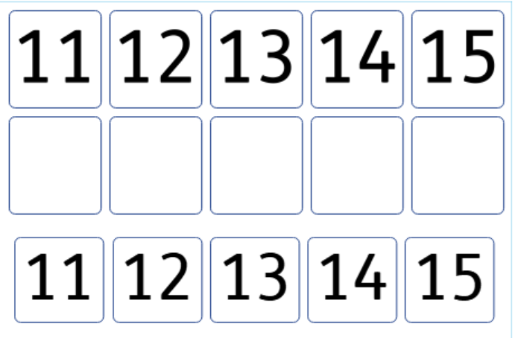

Slide 6
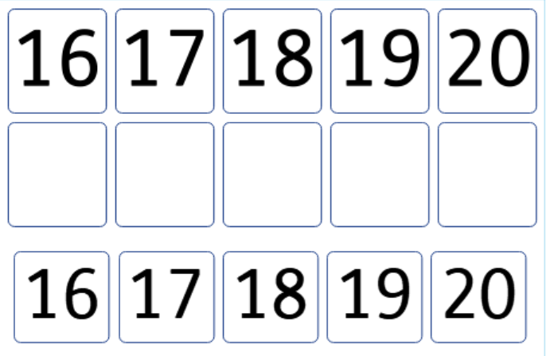

Slide 7
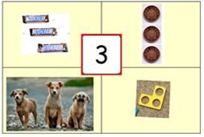
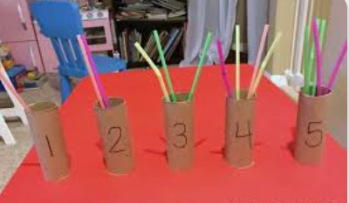

1:1 Correspondence and generalisation
Have a weekly number
Make a simple number display
Engage with this daily e.g. remove and re-Velcro saying “3 snickers” etc
Change items to help generalisation
A range of 1:1 correspondence activities
Change weekly
Get ideas and resources from early years

Slide 8
One to One Correspondence
Make copies of the following slides change numbers according to need.
Have students place the required number of items on the sheet.
Vary the items you use weekly(?) – buttons, counters trains etc etc.
Count out loud / have them count out loud as items are placed on the
(NB. laminating allows you to build a bank of reuseable resources)

Slide 9
2

Slide 10
11

Slide 11
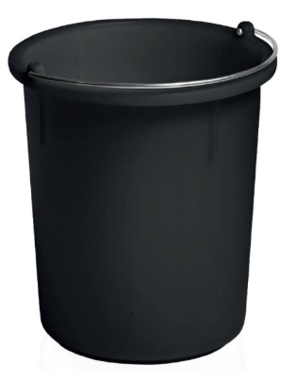
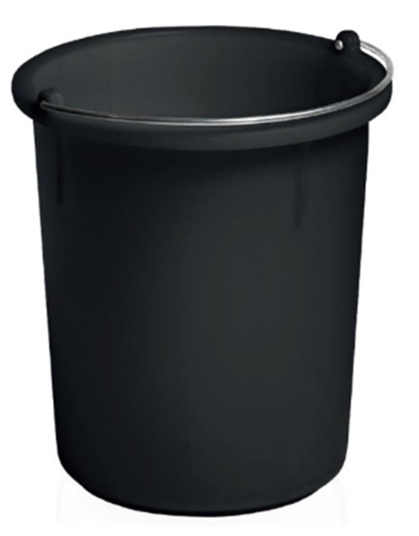


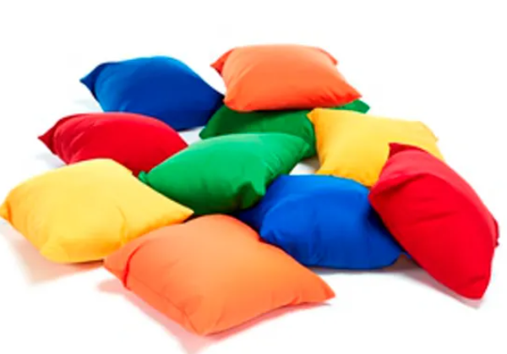
Active Numbers
Use large letter flashcards
Use PE hoops
Say a sound and have one or all students race to put the correct number of bean bags in the hoop / bucket

