Slide 1
SRS Outreach Responding to a Text
Understanding Themes
Resources can be cut and pasted from this pack

Slide 2





Slide 3
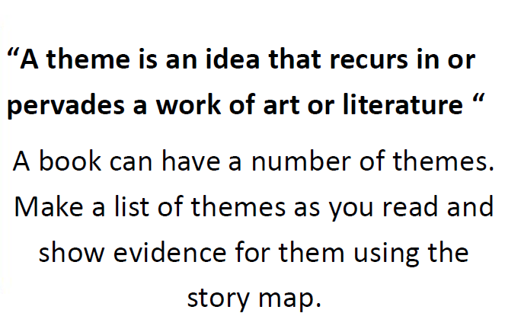


Slide 4
Evidence in the story

