Slide 1


SRS Outreach Writing Scaffold
………............................................
Diary Writing
Resources can be cut and pasted from this pack

Slide 2



Diary Writing
(insert character picture)
Diary
Don’t forget to use
My Name:
Date:
Dear Diary,
Something strange has happened and I am going to tell you all about it.
________________________________________________________
________________________________________________________
________________________________________________________
________________________________________________________
________________________________________________________
________________________________________________________

Slide 3

Diary Writing
___________________________________________________________________________________________________
___________________________________________________________________________________________________
___________________________________________________________________________________________________
___________________________________________________________________________________________________
___________________________________________________________________________________________________
___________________________________________________________________________________________________
___________________________________________________________________________________________________
___________________________________________________________________________________________________
Paragraphs:
2
3
4
Sentences:
1
2
3
4

Slide 4

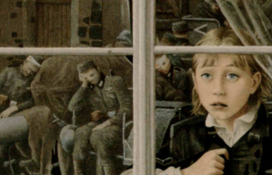





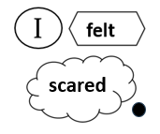
Diary Writing – Rose Blanche
1
2
3

Slide 5
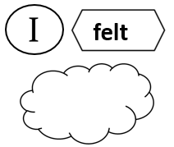
Diary Writing
1
2
3

Slide 6




Diary Writing
felt

Slide 7
Diary Writing
This scaffold is designed to help students see how to lay out their written work.
This scaffold is on power point and can therefore be edited to meet your specific needs. You can easily import pictures e.g. a character photo.
You can use images from the story or draw your own story map.
Think how many sentences you want your student to write and set a target. Increase or decrease the number of items on the story map accordingly. Sentences are numbered in yellow. More than one sentence could be written for each box.
Opening sentences are very hard to compose. You may wish to provide this. Students can then get on with writing their ideas.
This scaffold is designed to be written on. For some students you may prefer to use it as a visual aid and allow students to write in their books.
You can make organizing writing into paragraphs more visually explicit by writing purple numbers alongside their plan to indicate new paragraphs. if this is a familiar routine they will quickly learn what is required.

