Slide 1


SRS Outreach Writing Scaffold
………............................................
Story Planning
Resources can be cut and pasted from this pack

Slide 2
Notes:
The small scaffolds can be used to show a student how to organize their story into paragraphs. They are not designed to be written on.
Breaking the story into visible chunks can help with target setting each lesson. Each paragraph can be crossed off when completed. This can be motivating.
The Larger format could be further enlarged to A3, and a quick story / mind map added to each box to plan with the student what to write in each paragraph. This can be done while ‘checking in’ so supporting student’s short-term memory. Add any essential spellings.
This does not replace it supplements usual class planning and provides a visual summary for those students that need it.
The challenge allows you to add an adapted instruction linked to the class LO e.g. ‘add two frontal adverbials from these choices.

Slide 3
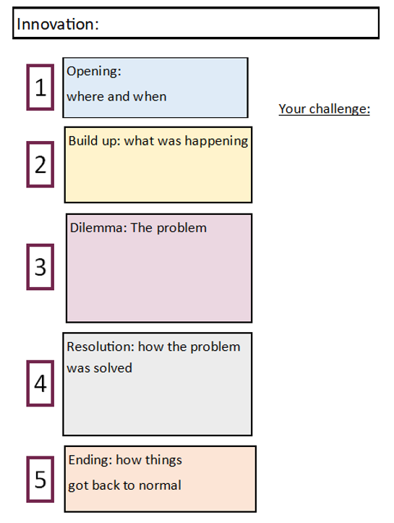
Story Overview

