Slide 1
SRS Outreach Writing Scaffold
Biography Scaffold
and Vocabulary / Word Bank
Resources can be cut and pasted from this pack

Slide 2

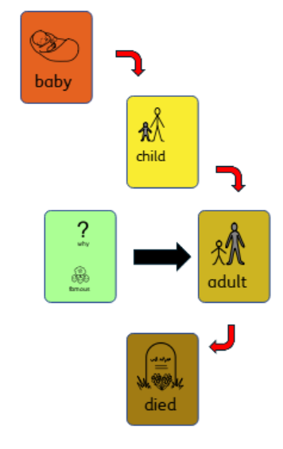
A biography is when you write about a person and what happened in their life.

Slide 3
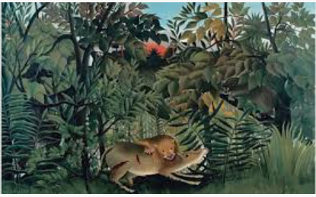

Jean Jacques Rousseau

Slide 4
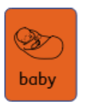
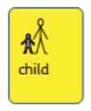
Paragraph 1
Insert relevant vocabulary
Date:

Slide 5
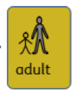

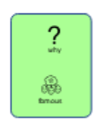
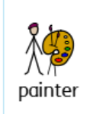
Paragraph 2
Insert relevant vocabulary

Slide 6
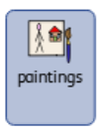



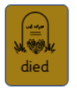

Paragraph 3
Insert relevant vocabulary
Date:

Slide 7

Paragraph 3
Insert relevant vocabulary
Why xxxxx
is important today?

