Slide 1
SRS Outreach Writing Scaffold
Newspaper Articles
Resources can be cut and pasted from this pack

Slide 2
Notes
Here is a scaffold for writing a newspaper article. You can use this any way you wish – drop individual slides into your power point.
Feel free to change slides!
Before writing record ideas on a simple flow chart or mind map and then concentrate on writing simple grammatically correct sentences.

Slide 3


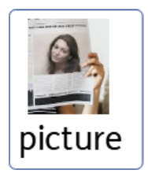
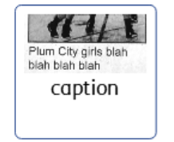

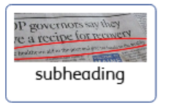

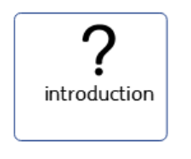




Key vocabulary and visuals

Slide 4
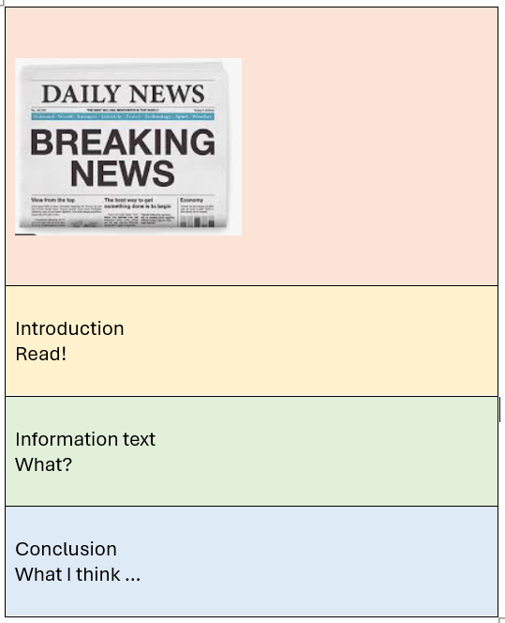

Headline

Slide 5

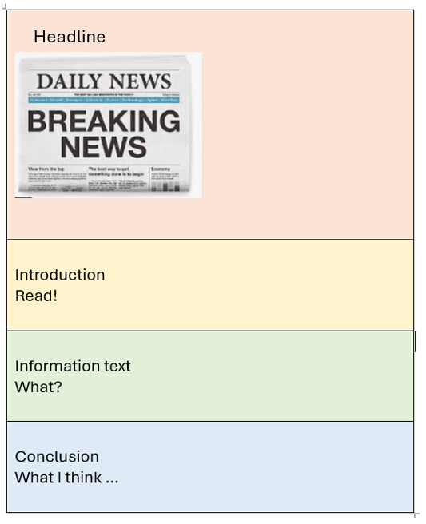

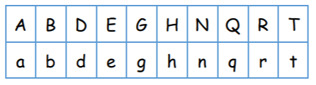
Headline
A VERY SAD DAY!
Use capital letters
6 words max!
(teacher model – students do: e.g A SAD DAY! Give students strips of paper and fat pens to make headlines)

Slide 6
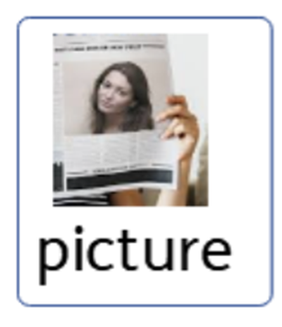
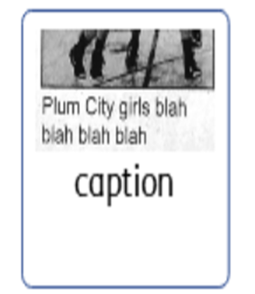

Caption
Use lower case letters
10 words max!
Goes under picture
Bruno says goodbye to his best friend.
(teacher models – students do: Give students strips of paper and fat pens to make captions for pictures)

Slide 7
Headline
Use lowercase letters
20 words max!
Tells us what is coming next
(teacher model – only if writing multiple paragraphs)

Slide 8

Introduction
(teacher model – students do e.g. The article is about ……………)

Slide 9


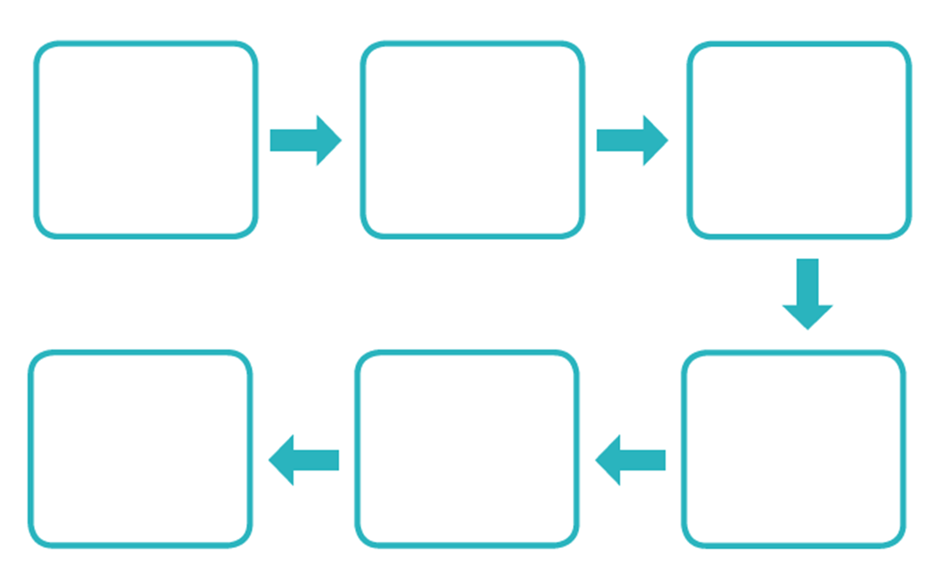
Information
(teacher story maps – students write own version)

Slide 10


Information
(teacher story maps – students write own version)

Slide 11

Conclusion
(teacher model – I think……………)

Slide 12




Word Bank

